Slide 1
Data Analytics Task
Customer Satisfaction Investigation

Slide 2
Overview
The Chief Operating Officer of a wireless phone company, TelCo Inc., has noticed that the company’s customer satisfaction scores have been dropping. Additionally, the call volume in their customer service center has been increasing, which is driving increased operating costs. After analyzing the data to try to understand the reasons behind this we will present recommendations based on our analysis to enhance customer’s satisfaction score.

Slide 3
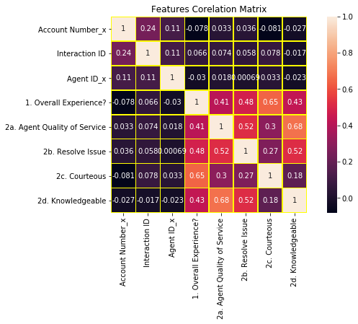
Correlation Matrix
We start this with the correlation Matrix, It tells us the strength of correlation between features, The darker the color the stronger the correlation, This visual tells us that Overall Experience is has a moderated correlation with (Agent Quality of service, Resolve Issue and Knowledge), Also a strong Correlation with (Courteous).

Slide 4
Overall Exp. by Courteous Ratings
As we see the more Courteous rating the more possibility the customer would be satisfied, In this graph as we notice if courteous is rated 5 it’s more likely the customer’s overall experience rating will be 5.

Slide 5
Overall Exp. by QOS Ratings
As we see also the more Quality of Service from the agent the more possibility the customer would be satisfied, Most of high rated Overall exp. had a high quality service, Rated 1 and 2 have a relatively low quality of service.

Slide 6
Ovr Exp. by Resolving Issue Ratings
Again we see also the more Resolve Issue quality from the agent the more possibility the customer would be satisfied, Most of high rated Overall exp. had a Resolve Issue ratings , Rated 1 and 2 hae a relatively low quality of Resolving Issue.

Slide 7
Ovrall Exp. by Knowledge Ratings
As we see also the more Knowledge from the agent the more possibility the customer would be satisfied, Most of high rated Overall exp. had a high quality service, Rated 1 and 2 have a relatively low quality of service.

Slide 8
We notice from the previous plots that ratings from 3-5 nearly all of them requires an average of 4 or higher rating in the other 4 features, Agents being rated 4 or above in other features will have high probability of gaining a pleased customer satisfaction.

Slide 9
Overall Exp. Ratings by Call Reasons Type
We can see all poor(1) Overall exp. calls were about add service, Rated fair(2) are mostly also about add service and with smaller values (Make payment and Handset Questions)

Slide 10
Overall Exp. Ratings by Call Resolution Type
As we can see all poor(1) Overall exp. calls ended by Transfer, Rated fair(2) are mostly also about Transfer and with smaller values (Phone disconnect, Add Text and Activate Handset)

Slide 11
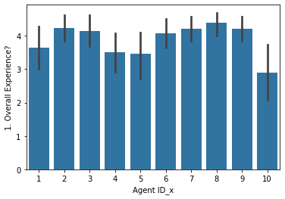
Agents Overall Experience Rating Average
We can see here some agents rating mean is quit low especially agent 10, Agents 1,4 and 5 also need improvement to at least have an average of rating = 4 to ensure customer satisfaction.

Slide 12
As we observe agents ratings average, Agent 1,4,5 and 10 needs to perform better to increase customer’s satisfaction results as they are below their teammates.

Slide 13
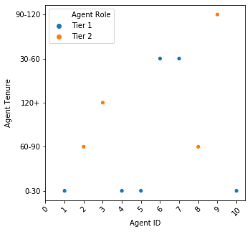
Agents Tenure Observation
This plot is to observe any common trait between the four agents, it's more obvious now, Those agents are hired recently and lacked of experience.

Slide 14
Conclusions
Some potential drivers of the decreased customer satisfaction and increased call volume :
According to these findings :
(A) Lacking in agent's (Knowledge, Service quality, Issue resolving leads to less customer satisfaction and increased call volume.
(B) Courteous is the most important feature here in affecting customer's satisfaction, It has a strong relation with customer's overall experience.
(C) Nearly all Poor and Fair ratings related to customers who request Adding services and the agent fails to satisfy them.
(D) Nearly all poor and fair ratings related to transferring the call to other dep. or call disconnecting.

Slide 15
Conclusions
Some potential recommendations to improve these issues :
(A) Demanding agents with average less than 4 in Knowledge feature to revise and enhance their knowledge.
(B) Emphasize the importance of Courteous with customers.
(C) Agents with service quality or issue resolving average less than 4 need to improve to achieve high customer satisfaction.
(D) If it's possible to reduce amount of calls about 'Adding service' to recently hired agents would be a good approach.
(E) The company should consider revising the call transferring protocols or increase observing transferring calls reasons.

Slide 16
Conclusions
Benefits of implementing these recommendations :
(A) Mainly lacking in knowledge would increases the call volume and cause less customer's satisfaction, So improvement from agents is needed.
(B)Courteous is greatly affecting customers overall experience, Emphasize the importance of it is important and causes customer's satisfaction to increase.
(C)The more service quality and problem solving from the agent the more the customer gets satisfied and the less call duration.
(D)Reducing amount of calls about 'Adding service' to recently hired agents to let them gain experience with less harm to Customer's satisfaction as all poor rated calls are about 'Adding Service'
(E)Transferring calls to other department upsets many customers for a reason, The company should revise the transferring protocols to avoid wasting the customer's time without any need or misunderstanding from the agent which also increases the call duration and would make the customer consider this as a bad experience.¶

Slide 17
End of Slides

